Slide 1
MEDICOLEGAL ASPECTS OF DEATH INVESTIGATION
DR KUNAL ANIMESH
MBBS, MD

Slide 2
Rigor Mortis
Cadaveric Rigidity/ PM stiffening/ Death Stiffening.
Rigor : rigidity , mortis : Death
Rigor mortis is post-mortem stiffening of voluntary and involuntary muscles of the body with slight shortening of the fibers,
that develops at variable periods after death and succeeds the state of primary flaccidity.
It indicates molecular death of concerned muscles.It disappears with onset of decomposition.
It does not start in all muscle simultaneously.(NYSTEN”S RULE).

Slide 3
Rigor Mortis
When rigor mortis is developed fully in the joints, they become fixed, extended or flexed depending on the position of the body at the time of death.
The flexion attitude is due to shortening of the muscles of forearm and legs.
Once rigor mortis is broken down by force, it does not reappear.
However, when it is not broken it passes off spontaneously and is followed by a phase of secondary muscular relaxation.

Slide 4
Rigor develops in the resting position in the body at the time of death, and when fully developed, is strong enough to support the body by the head and ankles.

Slide 5
Mechanism of Rigor Mortis
Muscles of the body consist of muscle fibres and muscles fibres consist of densely packed myofibrils extending throughout its whole length.
Myofibrils are contractile elements and are made up of two types of protein filaments; Myosin and Actin.
In Relaxed condition- The Actin filaments interdigitate with the myosin filaments only to a small extent.
During life, the separation of the Action & Myosin filaments, and the energy needed for contraction are dependent on ATP.

Slide 6
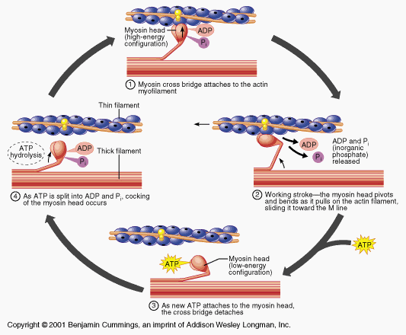
Mechanism of Muscle contraction

Slide 7
Rigor mortis

Slide 8
Mechanism of Rigor Mortis Contd.-
On nervous stimulation, hydrolysis of ATP occurs to ADP & PO₄ with the liberation of energy causes contraction of muscles and extension of actin filaments more into myosin filaments.
After death, there is continuous hydrolysis of ATP leading to increased accumulation of lactates & PO₄ in the muscles, and
As long as glycogen is available in the muscles, there is re-synthesis of ATP.
Once the glycogen is exhausted, no further re-synthesis of ATP.

Slide 9
Mechanism of Rigor Mortis Contd.-
When the ATP is reduced to a critical level (85% of the normal), the overlapping portions of myosin & actin filaments combine as rigid link of Actomyosin, & causes hardness and rigidity of muscle.
Rigidity of the muscle is at its maximum, when the level of ATP is reduced to 15%.
The time of onset of rigor mortis is directly proportional to the glycogen content of the muscle at the time of death.
Glycogen content depends upon whether the muscle was in a state of rest or activity before death.

Slide 10
Mechanism of Rigor Mortis Contd.-
After the pH of the muscles becomes 5.5, release of autolytic enzymes stored in lysosomes take place.
These enzymes act at the myofibrillar proteins & hydrolyze them.
As a result, the Actinomyosin complex is broken down & muscles become soft again.
This is known as resolution of rigor mortis.
It occurs during the state of secondary relaxation, due to decomposition.

Slide 11
Mechanism of Rigor Mortis
It has 4 phases .
1st phase:- muscle remain normal for some time after somatic death. But rapid onset in vigorous exercise prior to death like epilepsy, Tetany, electrocution, strychnine.
2nd phase:- ATP fall below critical level i.e. 85% cross bridges remain bound---muscle become viscous, inelastic, inextensible, dehydrated, stiff, gel like state.
ONSET Of Rigor Mortis
Still reversible if ATP & O₂ is added

Slide 12
Mechanism of Rigor Mortis
3rd phase:- RM fully developed.
ATP is fall to 15%.
4th phase:- phase of resolution, rigidity disappear d/t denaturation by autolysis & excess acid production during rigidity

Slide 13
Rigor Mortis

Slide 14
The order of Appearance of Rigor:
All muscles of the body, both voluntary & involuntary are affected.
It occurs earlier in involuntary or smooth muscles than voluntary or striated muscles.
Changes are detected easily in smaller muscles
For practical purposes, corpse may be divided into 3 categories-
1.Those which are still warm without showing any rigor: death within few hours
2. Those in which rigor is progressing but not established in entire body : death within 4-12hrs

Slide 15
Those in which rigor is well developed in entire body : death beyond 9-12hrs.
Time of Onset–In India (Tropical countries): (Rule of 12)
It begins 1-2 hrs after death & takes about 9-12 hrs to develop from head to foot, persist for another 12 hrs & takes 12 hrs to pass off
Duration of Rigor mortis:
In Northern India, It lasts 24-48 hrs in Winter & 18-36 hrs in Summer.

Slide 17
Order of Appearance of Rigor mortis
Right Face Left
↓
Hand←forearm←arm←neck & lower jaw → arm→ forearm → hand
↓
Thorax
↓
Foot ← leg ← thigh← abdomen & pelvis → thigh → leg → foot
Not related to nerves action
Develops in paralyzed limbs also
First appear in involuntary muscles
Last to be affected finger and toes muscles.
The disappearance of rigor follows same pattern as its appearance.

Slide 18
This man died holding a pillow

Slide 19
A man shot himself in the mouth with a rifle, holding the barrel with his left hand and depressing the trigger with his right thumb

Slide 20
Testing of Rigor mortis
Try to open eye lid.
Depressing jaw.
Gently bending neck & other joint.
Lift the leg by putting the hand above the knee joint under the thigh
Knee joint will not flex due to stiffness
If RM is complete & broken by mechanical force e.g. if a limb in rigor is flexed forcibly at a joint, the limb become flaccid & will remain so thereafter.

Slide 21
RM In Involuntary Muscle
Degree of change varies in each pupil.
ventricular contraction due to RM
mimic Myocardial Hypertrophy
RM in erector pile d/t agonal
contraction of erectors pilorum muscle-
goose skin or cutis anserine.
RM in dartos muscle give pressure to
testis & epididymis & causes postmortem ejaculation of semen. Also seen in asphyxia.
Post-mortem delivery may occur
EYE
HEART
SKIN
Scrotum
UTERUS

Slide 22
Like muscles elsewhere in the body, the tiny muscles attached to hair follicles (erector pili) can undergo rigor and result in “goose bumps” or “chicken skin,” a condition known as cutis anserina

Slide 23
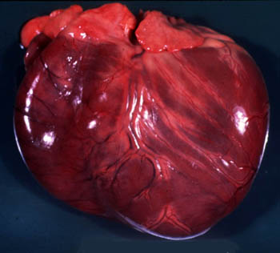
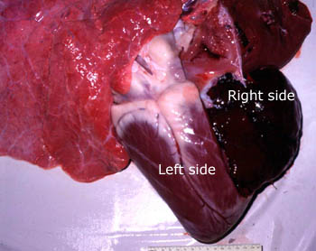
Rigor Mortis in Heart

Slide 24
Factor Affecting Rigor Mortis
Physical & Physiological Factor | Appear | Last | Passes Off
Wasting Ds | Early | Short | Early
Exhaustion | Early | Short | Early
Healthy Adult & Adolescent | Slow/Late | Longer | Slow
Children & Old | Early | Feeble /Short | Early
Warm Temp. | Early | - | Early
Cold Temp. | Late | - | Late
Drug Like Insulin | Early | - | Early
Thin Built | Early | - | Early
It Does not Occur In <7month IUL Fetus

Slide 25
S No | Pathological Condition | Onset | Passes Off
1 | Cholera, plague, typhoid, T.B, tetanus, cancer, electrocution, convulsion, hyperpyrexia, metabolic acidosis, uremia. | Early | Early
2 | Asphyxia, Apoplexy, Hypothermia, Pneumonia, Nervous Ds Like Paralysis Of Muscle, CO₂, CO Poisoning | Delayed | -
3 | Strychnine & Other Spinal Poison, Hydrocyanic Acid | Rapid | Longer
4 | Body Immersed In Cold Water | Rapid | Late

Slide 26
Medico-Legal Aspect
It’s a sign of death.
Its extent helps in estimating the time since death – Not Reliable.
It also help to determine position and attitude of the body at the time of death.
May indicate place of death.
May give some idea about cause & nature of death by modifying factor.

Slide 27
Differential Diagnosis of Rigor Mortis
Cadaveric Spasm
Heat Rigor (Heat Stiffening)
Cold Stiffening
Gas Stiffening

Slide 28
Cadaveric Spasm
Instantaneous Rigor, Rigidity, Cataleptic Rigidity
The muscles that were contracted during life become stiff and rigid immediately after death without passing into the stage of primary relaxation.
Cadaveric spasm continues until rigor mortis is developed in the other muscles and only passes off in the state of secondary flaccidity.
The change preserves the exact attitude of the person at the time of death for several hrs afterwards.

Slide 29
Cadaveric Spasm
Usually limited to a single group of voluntary muscles, frequently involves the hands.
No other condition simulates cadaveric spasm.
A great force is required to overcome this stiffness.
Mechanism: obscure but …
Exhausted ATP store in affected muscle.
Adrenocortical exhaustion which interfere with resynthesis of ATP.
It is associated with violent death, under circumstances of intense emotion.

Slide 30
Cadaveric Spasm
Drowning: Twig, grass, vegetation grasped in hand, IMPOSSIBLE TO EXTENED FINGER.
Fire arm wound of head involving brain.
Certain poisoning like Cyanide, Strychnine.
Suicidal death rare i.e. razor, knife, revolver found in hand.
In some homicide: cloth & its belonging, hairs of assailant are found & help in identifying the assailant.
In Accident: mountain fatalities branches of shrub, tree are seized by the deceased.

Slide 31
Cadaveric spasm

Slide 32
Cadaveric Spasm

Slide 33
Cadaveric Spasm

Slide 34
Medico-legal Importance of Cadaveric Spasm
Its a sign of death.
It suggest nature & mode of death.
It indicate position & attitude of body at the time of death.
Identify assailant .
Place of occurrence.
Time since death with RM & putrefaction.

Slide 35
Difference b/w Rigor Mortis and Cadaveric Spasm
Trait | Rigor Mortis | Cadaveric Spasm
Mechanism | Known | Not Clearly Known
Predisposing factor | Nil | Present
Time of onset | 1-2 hrs after death | Instantaneous
Muscles Involved | All the muscles of the body | Group of voluntary muscles

Slide 36
Difference b/w Rigor Mortis and Cadaveric Spasm
Trait | Rigor Mortis | Cadaveric Spasm
Muscles Stiffening | Not Marked | Marked
Molecular death | Occurs | Does not occur
Body Heat | Cold | Warm
Electrical Stimuli | Do not respond | Respond
MLA | Time of Death | Mode of Death

Slide 37
Differences b/w Rigor Mortis & Heat stiffening
Feature | Rigor mortis | Heat stiffening
Mechanism | Due to breakdown of ATP of muscles | Due to heat coagulation of muscle protein
Time of formation | 2-12 h after death | Can be ante-mortem of postmortem
Role of heat | High temperature enhances the process | Occur at a temperature > 65 ⁰C
Onset | In sequence | Rapid and diffuse

Slide 38
Heat Stiffening

Slide 39
Differences b/w Rigor Mortis & Heat Stiffening
Feature | Rigor mortis | Heat stiffening
Degree of stiffness | Moderate | High
Mechanical pull at joints | Will revert to rigidity extension (if not fully developed) | Rupture of muscles may occur
External features | Nothing specific | Signs of exposure to heat; burning, blackening, blisters
Disappearance | In sequence at various duration | Uniform, with onset of putrefaction

Slide 40
Cold Stiffening
Seen when body is exposed to freezing temperature below 3.5⁰ C(40⁰ F).
Occurs due to solidification of fat, muscle, body fluid in extreme cold or freezing temp.
Crepitus or crackling of ice heard at flexing the joint. Water content form icicles.
It simulate RM. If body rewarm it develop RM.
In infant d/t cold, skin fold around neck simulate hanging or strangulation but not associated With injury or petechiae.
It is the only condition where shortening of muscle does not occur.

Slide 41
Cold Stiffening

Slide 42
Gas Stiffening
Accumulation of putrefaction gas in tissue.
It causes false rigidity resulting in stiff limbs.
It’s a sign of decomposition & very obvious from the discoloration, swelling and foul smell.
During decomposition protein and carbohydrates are splits into simpler form & liberate gas like H₂S, Mercaptane, CO₂, Methane, Ammonia.
Organism causing gas formation are Clostridium welchii, B. Coli, Staphylococcus, Non hemolytic Streptococci, Dypthroids, Proteous etc.

Slide 43
Gaseous Stiffening

